Slide 1

Alarm Clock System
Yitzy Meyer, Alaa Mubarak, Adam Sparkes, Andrei Tocu

Slide 2
Table of contents
1- Brainstorming and project palnning
2-Prototype overview and components
3- Harware implementation of each module:
Clock
Stopwatch
Alarm
Timer
4-Software
6-Limitations of the project
7-Conclusion
5-demonstration

Slide 3
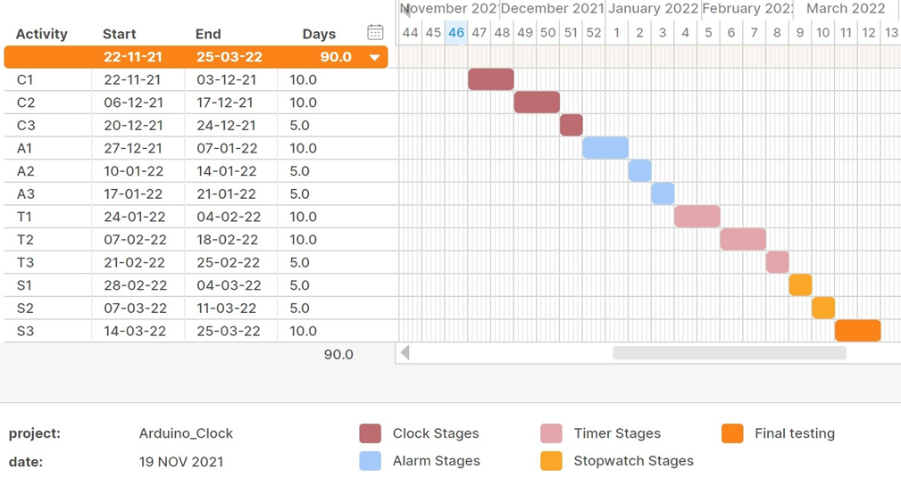
Brainstorming and Project Planning

Slide 4
Prototype overview
This project aims to design a fully-functioning digital clock with additional features of alarm, stopwatch, and timer.
The user should be able to use all functionalities concurrently.
The user should be able to fully control the time: set and reset each module.
The final design should be adjustable and easy to use.

Slide 5
Harware Components
Adafruit ItsyBitsy nRF52840 board.
Joystick
RTC
RGB LED
Buzzer
LCD display
220-ohm resistors: quantity (2)
Breadboard
Jumpwires

Slide 6
The Menu
The main menu has the four functionalities: clock, alarm, timer and stopwatch
The navigation is done using a joystick. Menus can be changed using up/down movements, while submenu shuffle can be done using left/right movements.
To enter/exit a menu press the joystick down, vertically – a switch will be actioned.

Slide 7
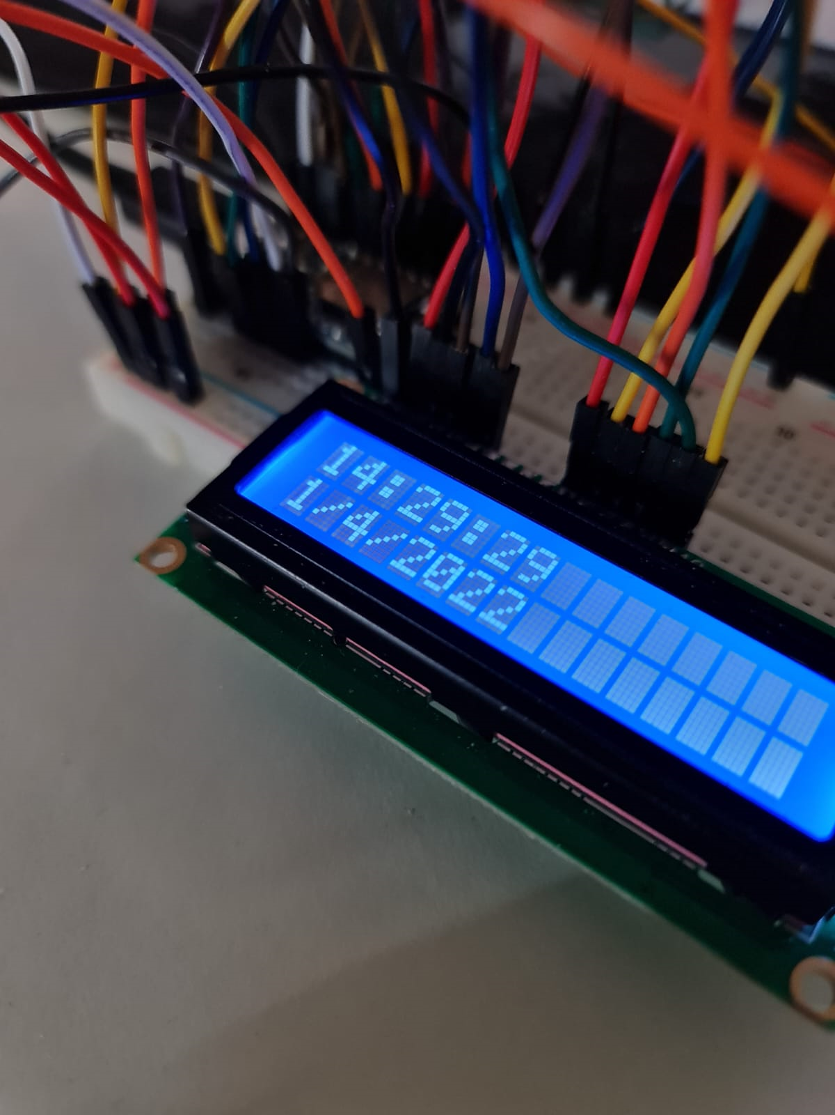
Clock
This module has no submenus, and when selected it will display both the time and the date.
Time format H:M:S
Date format D/M/Y

Slide 8
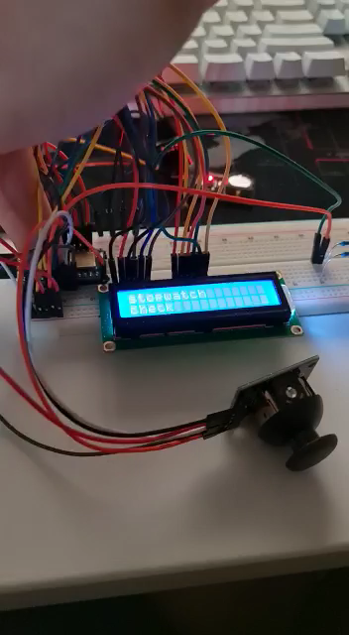
Clock demo

Slide 9
Stopwatch
Can be started and stopped at will for exact timing.
It starts from zero up to, theoretically, over 35K mins.
It displays the time passed min:sec format.
It has 3 submenus: Start, Check, and Reset.

Slide 10
Stopwatch
Selecting the start submenu will have the stopwatch counting the time passed.
If the stopwatch has been previously started by the user, accessing the start submenu again will set the submenu to “check”.
The submenu check shows the time passed since stopwatch was actioned. If it goes past 60 then it will display the minutes.
Entering submenu reset will set the value to 0, therefore, when accessing submenu check it will display “not started”.

Slide 11
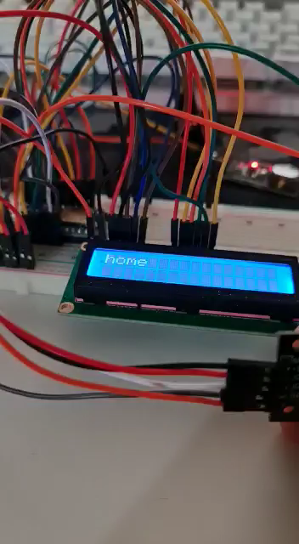
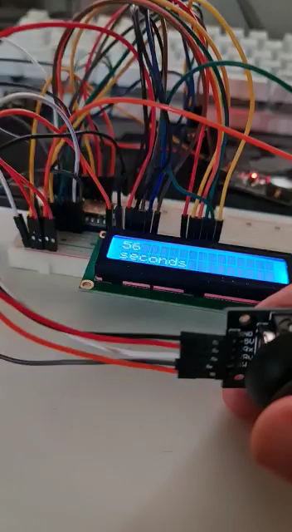
Stopwatch demo

Slide 12

Alarm
Allows the user to set the time by which they want to be altered or warned to do specific task using the buzzer.
Has 3 submenus: enable, disable and check.
Displays the time in H:M format.
In the check menu, you can see the time that the alarm will activate.
You can use the enable option to set the alarm time and disable to disable and reset the alarm.
This will run in the background while other programs of the alarm are active.

Slide 13
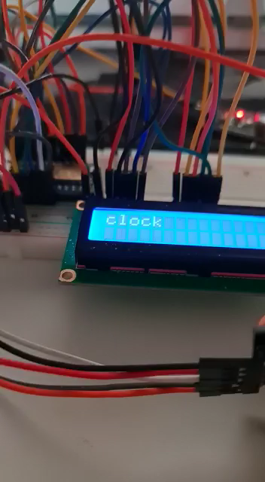
Alarm demo

Slide 14
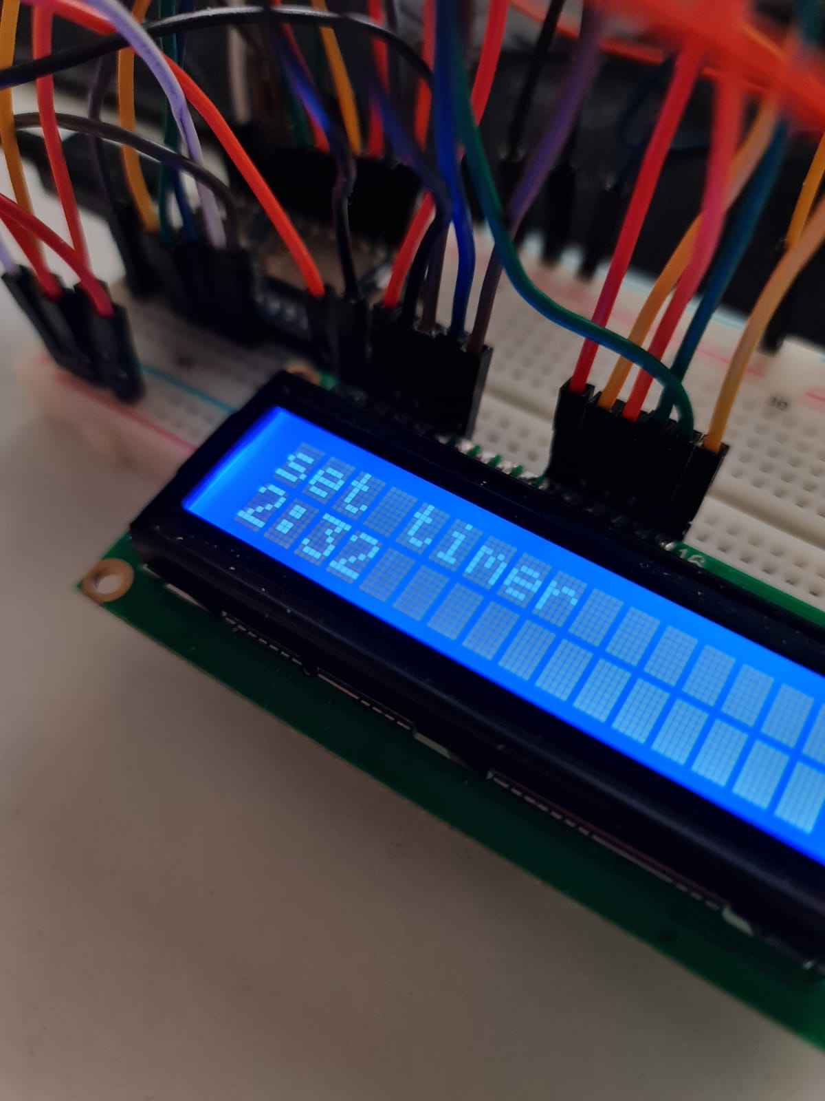
Timer
Timer has 3 submenus: set, check and reset.
Similar functionality of the stopwatch but user will set the timer values first.
Once started the timer will count down until it reaches zero, then the alarm will go off.
If it has been set already, it will navigate to the value to check how much time remains. If not, then it will allow the user to set the time and it will count down until it reaches zero.

Slide 15
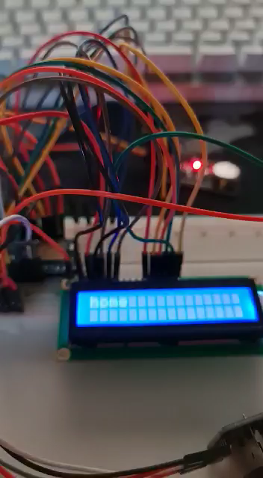
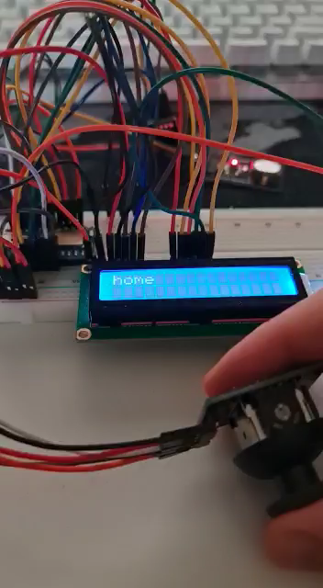
Timer demo

Slide 16
Software
The code is all written in C/C++ using Arduino IDE
Drivers of hardware such as RTC module, LCD and other libraries of the mainboard were supplied by the Arduino community (Adafruit) through the IDE.

Slide 17
Limitations of the Project
The number of digital pins was limited, so we had to use the joystick instead of the keypad to make use of analog bins.
The Joystick values were not accurate due to the large scale (from 0 to 1023), so we had to map them from (-9 to 9) for both X-axis and Y-axis to control it more accurately.
Another solution would be using Bluetooth by pairing it with Android app (Bluefruit) which provides more flexibility to control the system.

Slide 18
Challenges
Only way of input: up/down, left/right and enter
Keeping menu responsive and not overlapping
Features running concurrently
Many more…

Slide 19
Future Features
Ability of storing and reading data from the internal flash of the nRF52
Adding Bluetooth connectivity that allows for endless input options and display of data directly on phone

Slide 20
Thank you
Questions?

